Slide 1
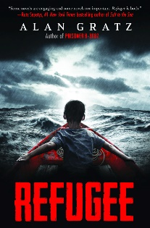
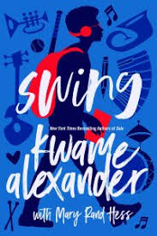
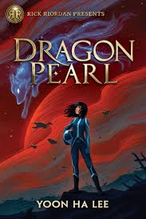
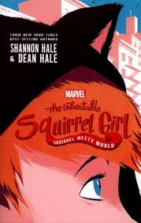
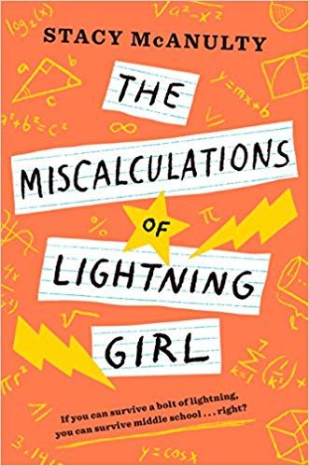
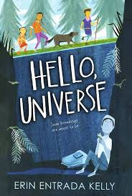
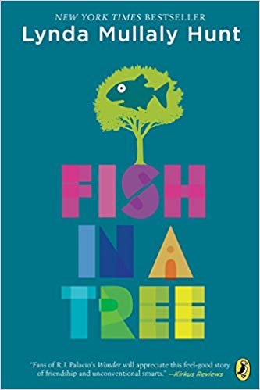
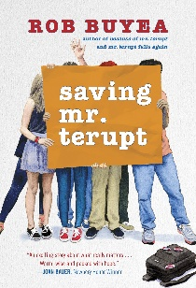
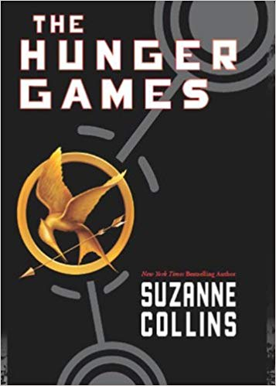
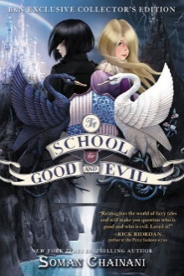
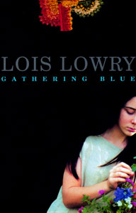
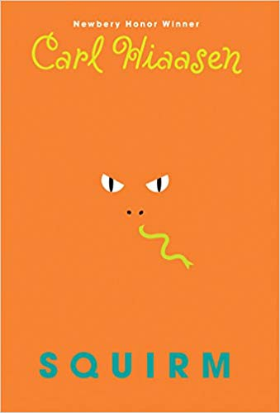
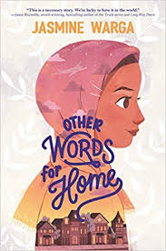
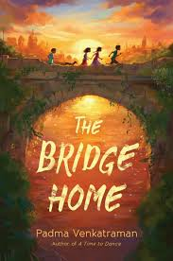
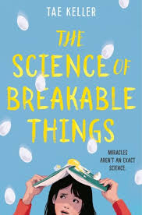
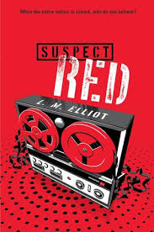
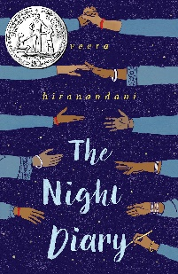
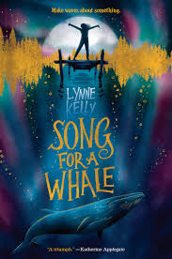
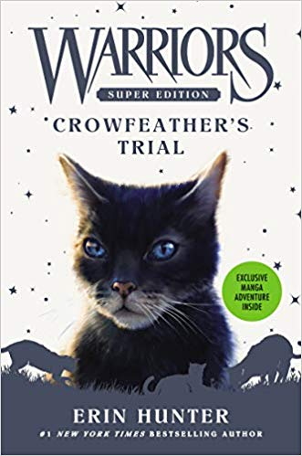
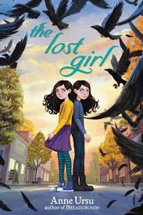
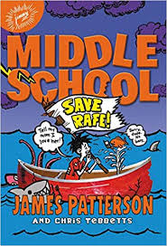
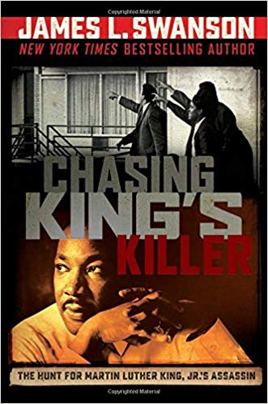
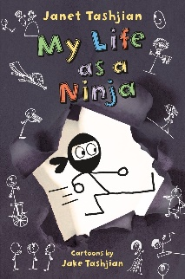
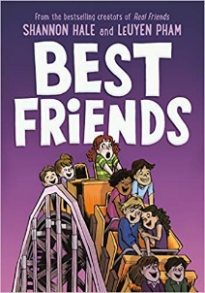
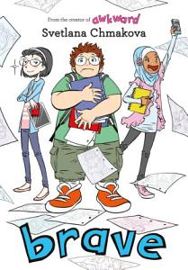
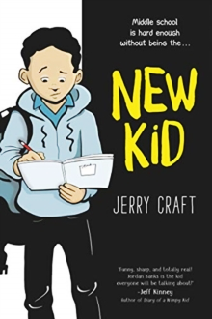
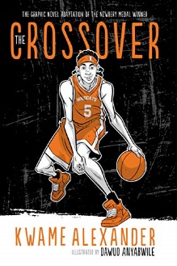
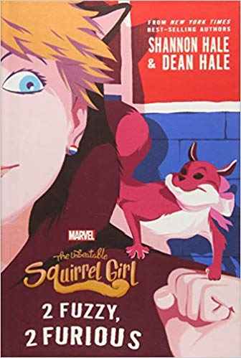
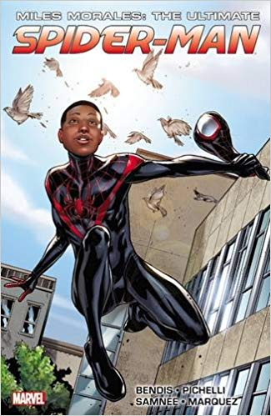
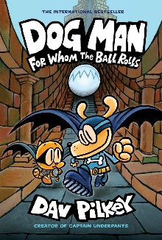
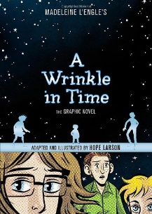
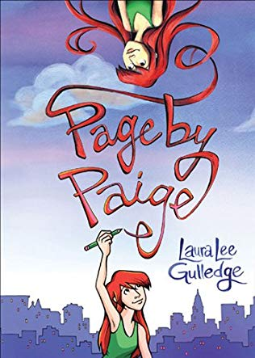
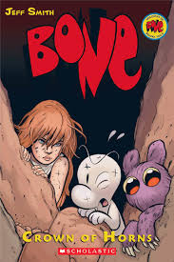
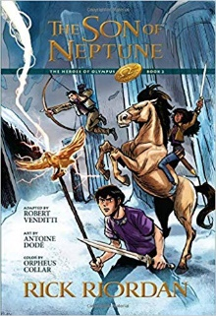
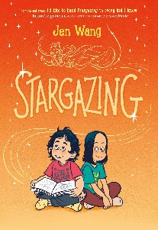
Search
Trending Now
New Arrivals
Featured Graphic Novels
Notes:
Book covers are animated by row – to change the pictures without breaking the animation, right-click on the image and select ‘change picture’, then add your chosen book cover ☺
Jane Hill, Learning Resource Manager, Kings Langley Secondary School, 2019.

Slide 2
Refugee by Alan Gratz
Three different kids. One mission in common: ESCAPE. Josef is a Jewish boy in 1930s Nazi Germany. With the threat of concentration camps looming, he and his family board a ship bound for the other side of the world… Isabel is a Cuban girl in 1994. With riots and unrest plaguing her country, she and her family set out on a raft, hoping to find safety and freedom in America… Mahmoud is a Syrian boy in 2015. With his homeland torn apart by violence and destruction, he and his family begin a long trek toward Europe… All three young people will go on harrowing journeys in search of refuge. All will face unimaginable dangers–from drownings to bombings to betrayals. But for each of them, there is always the hope of tomorrow. And although Josef, Isabel, and Mahmoud are separated by continents and decades, surprising connections will tie their stories together in the end.
***From GoodReads.com
Back to BookFlix Homepage

Slide 3
Swing by Kwame Alexander
Things usually do not go as planned for seventeen-year-old Noah. He and his best friend Walt (aka Swing) have been cut from the high school baseball team for the third year in a row, and it looks like Noah’s love interest since third grade, Sam, will never take it past the “best friend” zone. Noah would love to retire his bat and accept the status quo, but Walt has big plans for them both, which include making the best baseball comeback ever, getting the girl, and finally finding cool.
**From GoodReads.com
Back to BookFlix Homepage

Slide 4
Dragon Pearl by Yoon Ha Lee
THIRTEEN-YEAR-OLD MIN comes from a long line of fox spirits. But you'd never know it by looking at her. To keep the family safe, Min’s mother insists that none of them use any fox-magic, such as Charm or shape-shifting. They must appear human at all times. Min feels hemmed in by the household rules and resents the endless chores, the cousins who crowd her, and the aunties who judge her. She would like nothing more than to escape Jinju, her neglected, dust-ridden, and impoverished planet. She’s counting the days until she can follow her older brother, Jun, into the Space Forces and see more of the Thousand Worlds. When word arrives that Jun is suspected of leaving his post to go in search of the Dragon Pearl, Min knows that something is wrong. Jun would never desert his battle cruiser, even for a mystical object rumored to have tremendous power. She decides to run away to find him and clear his name. Min’s quest will have her meeting gamblers, pirates, and vengeful ghosts. It will involve deception, lies, and sabotage. She will be forced to use more fox-magic than ever before, and to rely on all of her cleverness and bravery. The outcome may not be what she had hoped, but it has the potential to exceed her wildest dreams. (**From GoodReads.com)
Back to BookFlix Homepage

Slide 5
The Unbeatable Squirrel Girl: Squirrel Meets World by Shannon Hale
Fourteen-year-old Doreen Green moved from sunny California to the suburbs of New Jersey. She must start at a new school, make new friends, and continue to hide her tail. Yep, Doreen has the powers of . . . a squirrel! After failing at several attempts to find her new BFF, Doreen feels lonely and trapped, liked a caged animal. Then one day Doreen uses her extraordinary powers to stop a group of troublemakers from causing mischief in the neighborhood, and her whole life changes. Everyone at school is talking about it! Doreen contemplates becoming a full-fledged Super Hero. And thus, Squirrel Girl is born!
***From GoodReads.com
Back to BookFlix Homepage

Slide 6
The Miscalculations of Lightning Girl by Stacy McAnulty
Lucy Callahan was struck by lightning. She doesn't remember it, but it changed her life forever. The zap gave her genius-level math skills, and ever since, Lucy has been homeschooled. Now, at 12 years old, she's technically ready for college. She just has to pass 1 more test — middle school! Lucy's grandma insists: Go to middle school for 1 year. Make 1 friend. Join 1 activity. And read 1 book (that's not a math textbook!). Lucy's not sure what a girl who does calculus homework for fun can possibly learn in 7th grade. She has everything she needs at home, where nobody can make fun of her rigid routines or her superpowered brain. The equation of Lucy's life has already been solved. Unless there's been a miscalculation? (**From Goodreads.com)
Return to BookFlix Homepage

Slide 7
Hello, Universe by Erin Entrada Kelly
In one day, four lives weave together in unexpected ways. Virgil Salinas is shy and kindhearted and feels out of place in his loud and boisterous family. Valencia Somerset, who is deaf, is smart, brave, and secretly lonely, and loves everything about nature. Kaori Tanaka is a self-proclaimed psychic, whose little sister Gen is always following her around. And Chet Bullens wishes the weird kids would just act normal so that he can concentrate on basketball. They aren’t friends -- at least not until Chet pulls a prank that traps Virgil and his pet guinea pig at the bottom of a well. This disaster leads Kaori, Gen, and Valencia on an epic quest to find the missing Virgil. Through luck, smarts, bravery, and a little help from the universe, a rescue is performed, a bully is put in his place, and friendship blooms. (From GoodReads.com)
Back to BookFlix Homepage

Slide 8
When Dimple Met Rishi by Sandhya Menon
Dimple Shah has it all figured out. With graduation behind her, she’s more than ready for a break from her family, from Mamma’s inexplicable obsession with her finding the “Ideal Indian Husband.” Ugh. Dimple knows they must respect her principles on some level, though. If they truly believed she needed a husband right now, they wouldn’t have paid for her to attend a summer program for aspiring web developers…right? (**From GoodReads.com)
Back to BookFlix Homepage

Slide 9
Ghost by Jason Reynolds
Running. That's all that Ghost (real name Castle Cranshaw) has ever known. But never for a track team. Nope, his game has always been ball. But when Ghost impulsively challenges an elite sprinter to a race -- and wins -- the Olympic medalist track coach sees he has something: crazy natural talent. Thing is, Ghost has something else: a lot of anger, and a past that he is trying to outrun. Can Ghost harness his raw talent for speed and meld with the team, or will his past finally catch up to him?
**from GoodReads.com
Back to BookFlix Homepage

Slide 10
Escape From Mr. Lemoncello’s Library by Chris Grabenstien
Kyle Keeley is the class clown, popular with most kids, (if not the teachers), and an ardent fan of all games: board games, word games, and particularly video games. His hero, Luigi Lemoncello, the most notorious and creative gamemaker in the world, just so happens to be the genius behind the building of the new town library. Lucky Kyle wins a coveted spot to be one of the first 12 kids in the library for an overnight of fun, food, and lots and lots of games. But when morning comes, the doors remain locked. Kyle and the other winners must solve every clue and every secret puzzle to find the hidden escape route. And the stakes are very high. (From GoodReads.com)
Back to Bookflix Homepage

Slide 11
Fish in a Tree by Lynda Mullaly Hunt
Ally has been smart enough to fool a lot of smart people. Every time she lands in a new school, she is able to hide her inability to read by creating clever yet disruptive distractions. She is afraid to ask for help; after all, how can you cure dumb? However, her newest teacher Mr. Daniels sees the bright, creative kid underneath the trouble maker. With his help, Ally learns not to be so hard on herself and that dyslexia is nothing to be ashamed of. As her confidence grows, Ally feels free to be herself and the world starts opening up with possibilities. She discovers that there’s a lot more to her—and to everyone—than a label, and that great minds don’t always think alike. (From GoodReads.com)
Back to BookFlix Homepage

Slide 12
Saving Mr. Terupt by Rob Buyea
The kids from Mr. Terupt’s fifth- and sixth-grade classes are entering their first year of junior high school. There’s a lot to be excited about, but there are new challenges, too. Peter and Jeffrey face tough competition on their wrestling team. Alexiahas a disastrous first day of school, and that’s only the beginning. Anna is desperate for Charlie to propose to her mother—what is he waiting for?! Danielle isn’t feeling so well, but she's trying to tough it out, like Grandma. Trouble with a bully makes Luke dread going to school for the first time ever.And Jessica is waiting anxiously for an acceptance to a theater retreat in New York City. Everyone is missing Mr. Terupt. When a fight threatens to break up the group forever, they think their favorite teacher is the only one who can help them. But the kids soon find out that it’s Mr. Terupt who needs saving. (**From GoodReads.com)
Back to BookFlix Homepage

Slide 13
The Hunger Games by Suzanne Collins
In the ruins of a place once known as North America lies the nation of Panem, a shining Capitol surrounded by twelve outlying districts. The Capitol is harsh and cruel and keeps the districts in line by forcing them all to send one boy and one girl between the ages of twelve and eighteen to participate in the annual Hunger Games, a fight to the death on live TV. Sixteen-year-old Katniss Everdeen, who lives alone with her mother and younger sister, regards it as a death sentence when she is forced to represent her district in the Games. But Katniss has been close to dead before - and survival, for her, is second nature. Without really meaning to, she becomes a contender. But if she is to win, she will have to start making choices that weigh survival against humanity and life against love. (**FromGoodReads.com)
Back to Bookflix Homepage

Slide 14
The School of Good and Evil by Somani Chainani
This year, best friends Sophie and Agatha are about to discover where all the lost children go: the fabled School for Good & Evil, where ordinary boys and girls are trained to be fairy tale heroes and villains. As the most beautiful girl in Gavaldon, Sophie has dreamed of being kidnapped into an enchanted world her whole life. With her pink dresses, glass slippers, and devotion to good deeds, she knows she’ll earn top marks at the School for Good and graduate a storybook princess. Meanwhile Agatha, with her shapeless black frocks, wicked pet cat, and dislike of nearly everyone, seems a natural fit for the School for Evil. But when the two girls are swept into the Endless Woods, they find their fortunes reversed—Sophie’s dumped in the School for Evil to take Uglification, Death Curses, and Henchmen Training, while Agatha finds herself in the School For Good, thrust amongst handsome princes and fair maidens for classes in Princess Etiquette and Animal Communication.. But what if the mistake is actually the first clue to discovering who Sophie and Agatha really are…? (From Goodreads.com)
Back to BookFlix Homepage

Slide 15
Gathering Blue by Lois Lowry
In her strongest work to date, Lois Lowry once again creates a mysterious but plausible future world. It is a society ruled by savagery and deceit that shuns and discards the weak. Left orphaned and physically flawed, young Kira faces a frightening, uncertain future. Blessed with an almost magical talent that keeps her alive, she struggles with ever broadening responsibilities in her quest for truth, discovering things that will change her life forever. (***From GoodReads.com)
Back to BookFlix Homepage

Slide 16
Squirm by Carl Hiassen
Some facts about Billy Dickens:
* He once saw a biker swerve across the road in order to run over a snake. * Later, that motorcycle somehow ended up at the bottom of a canal. * Billy isn't the type to let things go. Some facts about Billy's family: * They've lived in six different Florida towns because Billy's mom always insists on getting a house near a bald eagle nest. * Billy's older sister is dating a jerk. It's a mystery. * Billy's dad left when he was four, and Billy knows almost nothing about him. * Billy has just found his dad's address--in Montana. This summer, Billy will fly across the country, hike a mountain, float a river, dodge a grizzly bear, shoot down a spy drone, save a neighbor's cat, save an endangered panther, and then try to save his own father. (**FromGoodReads.com)
Back to BookFlix Homepage

Slide 17
Other Words for Home by Jasmine Warga
Jude never thought she’d be leaving her beloved older brother and father behind, all the way across the ocean in Syria. But when things in her hometown start becoming volatile, Jude and her mother are sent to live in Cincinnati with relatives. At first, everything in America seems too fast and too loud. The American movies that Jude has always loved haven’t quite prepared her for starting school in the US—and her new label of “Middle Eastern,” an identity she’s never known before. But this life also brings unexpected surprises—there are new friends, a whole new family, and a school musical that Jude might just try out for. Maybe America, too, is a place where Jude can be seen as she really is. (**From GoodReads.com)
Back to BookFlix Homepage

Slide 18
The Bridge Home by Padma Venkatraman
When Viji and her sister, Rukku, whose developmental disability makes her overly trusting and vulnerable to the perils of the world, run away to live on their own, the situation could not be more grim. Life on the streets of the teeming city of Chennai is harsh for girls considered outcasts, but the sisters manage to find shelter on an abandoned bridge. There they befriend Muthi and Arul, two boys in a similar predicament, and the four children bond together and form a family of sorts. Viji starts working with the boys scavenging in trash heaps while Rukku makes bead necklaces, and they buy food with what little money they earn. They are often hungry and scared but they have each other--and Kutti, the best dog ever. When the kids are forced from their safe haven on the bridge, they take shelter in a graveyard. But it is now the rainy season and they are plagued by mosquitos, and Rukku and Muthu fall ill. As their symptoms worsen, Viji and Arul must decide whether to risk going for help--when most adults in their lives have proven themselves untrustworthy--or to continue holding on to their fragile, hard-fought freedom. (**From GoodReads.com)
Back to BookFlix Homepage

Slide 19
The Science of Breakable Things by Tae Keller
How do you grow a miracle? For the record, this is not the question Mr. Neely is looking for when he says everyone in class must answer an important question using the scientific method. But Natalie's botanist mother is suffering from depression, so this is The Question that's important to Natalie. When Mr. Neely suggests that she enter an egg drop competition, Natalie has hope. Eggs are breakable. Hope is not. Natalie has a secret plan for the prize money. She's going to fly her mother to see the Cobalt Blue Orchids--flowers that survive against impossible odds. The magical flowers are sure to inspire her mother to love life again. Because when parents are breakable, it's up to kids to save them, right? (**From GoodReads.com)
Back to BookFlix Homepage

Slide 20
Spy School: British Invasion by Stuart Gibbs
Stranded in Mexico after nearly capturing the leaders of SPYDER, thirteen-year-old Ben Ripley desperately needs to take a shower. But even more so, he and his spy school friends need to come up with a new plan to defeat their enemies, their only clue a key that opens…something. (**From GoodReads.com)
Back to BookFlix Hompage

Slide 21
It Wasn’t Me by Dana Alison Levy
When Theo’s photographs are vandalized and trashed beyond all recognition, there are five kids at the scene: The Nerd, the Princess, the Jock, the Weirdo, and the Screw-Up. All anyone will say is “It wasn’t me.” Theo doesn’t care who it was, he just wants to stop being the victim. The sooner the school forgets the whole humiliating thing, the better. But his favorite teacher is asking the six of them to spend vacation week together “learning to trust” and getting to the truth. She calls it a Justice Circle. He calls it his worst nightmare. (**From GoodReads.com)
Back to BookFlix Homepage

Slide 22
Suspect Red by L.M. Elliot
It's 1953, and the United States has just executed an American couple convicted of spying for the Soviet Union. Everyone is on edge as the Cold War standoff between communism and democracy leads to the rise of Senator Joe McCarthy and his zealous hunt for people he calls subversives or communist sympathizers. Suspicion, loyalty oaths, blacklists, political profiling, hostility to foreigners, and the assumption of guilt by association divide the nation. Richard and his family believe deeply in American values and love of country, especially since Richard's father works for the FBI. Yet when a family from Czechoslovakia moves in down the street with a son Richard's age named Vlad, their bold ideas about art and politics bring everything into question. Richard is quickly drawn to Vlad's confidence, musical sensibilities, and passion for literature, which Richard shares. But as the nation's paranoia spirals out of control, Richard longs to prove himself a patriot, and blurred lines between friend and foe could lead to a betrayal that destroys lives. (**From GoodReads.com)
Back to BookFlix Homepage

Slide 23
The Parker Inheritance by Varian Johnson
When Candice finds the letter, she isn't sure she should read it. It's addressed to her grandmother, after all, who left Lambert in a cloud of shame. But the letter describes a young woman named Siobhan Washington. An injustice that happened decades ago. A mystery enfolding the letter-writer. And the fortune that awaits the person who solves the puzzle. Grandma tried and failed. But now Candice has another chance. So with the help of Brandon Jones, the quiet boy across the street, she begins to decipher the clues in the letter. The challenge will lead them deep into Lambert's history, full of ugly deeds, forgotten heroes, and one great love; and deeper into their own families, with their own unspoken secrets. Can they find the fortune and fulfill the letter's promise before the summer ends? (**From GoodReads.com)
Back to BookFlix Homepage

Slide 24
The Night Diary by Veera Hiranandani
Half-Muslim, half-Hindu twelve-year-old Nisha doesn't know where she belongs, or what her country is anymore. When Papa decides it's too dangerous to stay in what is now Pakistan, Nisha and her family become refugees and embark first by train but later on foot to reach her new home. The journey is long, difficult, and dangerous, and after losing her mother as a baby, Nisha can't imagine losing her homeland, too. But even if her country has been ripped apart, Nisha still believes in the possibility of putting herself back together. (**From GoodReads.com)
Back to BookFlix Homepage

Slide 25
Song For A Whale by Lynne Kelly
From fixing the class computer to repairing old radios, twelve-year-old Iris is a tech genius. But she's the only deaf person in her school, so people often treat her like she's not very smart. If you've ever felt like no one was listening to you, then you know how hard that can be. When she learns about Blue 55, a real whale who is unable to speak to other whales, Iris understands how he must feel. Then she has an idea: she should invent a way to "sing" to him! But he's three thousand miles away. How will she play her song for him? (**From GoodReads.com)
Back to BookFlix Homepage

Slide 26
Warriors: Crowfeather’s Trial by Erin Hunter
When a terrible danger rises within WindClan’s territory, it heightens tensions that are already growing in the wake of the battle with the Dark Forest. Caught between his son, Breezepelt, and their Clanmates, loyal warrior Crowfeather must conquer the ghosts of his past to make way for his Clan's future. (**From GoodReads.com)
Back to BookFlix Homepage

Slide 27
The Lost Girl by Anne Ursu
When you’re an identical twin, your story always starts with someone else. For Iris, that means her story starts with Lark. Iris has always been the grounded, capable, and rational one; Lark has been inventive, dreamy, and brilliant—and from their first moments in the world together, they’ve never left each other’s side. Everyone around them realized early on what the two sisters already knew: they had better outcomes when they were together. When fifth grade arrives, however, it is decided that Iris and Lark should be split into different classrooms, and something breaks in them both. Iris is no longer so confident; Lark retreats into herself as she deals with challenges at school. And at the same time, something strange is happening in the city around them, things both great and small going missing without a trace. As Iris begins to understand that anything can be lost in the blink of an eye, she decides it’s up to her to find a way to keep her sister safe. (**From GoodReads.com)
Back to BookFlix Homepage

Slide 28
Save Rafe! By James Patterson
James Patterson's hilarious story of perseverance and courage shows everyone's favorite troublemaker, Rafe Khatchadorian, the star of the Middle School series, learning to become a leader at long last. (**From GoodReads.com)
Back to BookFlix Homepage

Slide 29
Chasing King’s Killer by James L. Swanson
In his meteoric, thirteen-year rise to fame, Dr. Martin Luther King Jr. led a mass movement for Civil Rights -- with his relentless peaceful, non-violent protests, public demonstrations, and eloquent speeches. But as violent threats cast a dark shadow over Dr. King's life, Swanson hones in on James Earl Ray, a bizarre, racist, prison escapee who tragically ends King's life. (**From GoodReads.com)
**Back to BookFlix Homepage

Slide 30
Elvis and the Underdogs by Jenny Lee
Benji Wendell Barnsworth is a small ten-year-old boy with a big personality. Born premature, Benji is sickly, accident prone, and at the hospital so often he even has his own punch card. That is, until the day Benji wakes up from a particularly bad spell. Concerned for Benji's health, the doctor offers him two options: wear the world's ugliest padded helmet or get a therapy dog. Benji chooses the dog, of course. (**From GoodReads.com)
Back to BookFlix Homepage

Slide 31
My Life as a Ninja by Janel Tashjian
Derek Fallon has expanded his taste in cartoons to the world of manga and anime. Together with his friends Carly, Matt, and Umberto, Derek has fun learning about all the cool aspects of ninja culture. When someone starts vandalizing their school with graffiti of a mischievous troll-like figure, these ninjas-in-training are convinced they'll be able to crack the case. But it turns out that being a ninja is a lot more work than they thought, and this adventure brings about new opportunities for Derek to embarrass himself. For once, can he be the hero that saves the day? (**From GoodReads.com)
Back to BookFlix Homepage

Slide 32
Best Friends by Shannon Hale
This new graphic memoir picks up where "Real Friends" left off. As Shannon grows a little older, the rules of friendship always seem to be changing, leaving her guessing and trying her best to just keep up. "Best Friends" shares its predecessor's frankness, compassion, and enthralling, heartfelt visual storytelling. Junior high, as it turns out, is quite the roller coaster. (**From Good Reads.com)
Back to BookFlix Homepage

Slide 33
Brave by Svetlana Chmakova
In his daydreams, Jensen is the biggest hero that ever was, saving the world and his friends on a daily basis. But his middle school reality is VERY different - math is hard, getting along with friends is hard...Even finding a partner for the class project is a big problem when you always get picked last. And the pressure's on even more once the school newspaper's dynamic duo, Jenny and Akilah, draw Jensen into the whirlwind of school news, social experiment projects, and behind-the-scenes club drama. Jensen's always played the middle school game one level at a time, but suddenly, someone's cranked up the difficulty setting. Will those daring daydreams of his finally work in his favor, or will he have to find real solutions to his real life problems? (**From GoodReads.com)
Back to BookFlix Homepage

Slide 34
New Kid by Jerry Craft
Seventh grader Jordan Banks loves nothing more than drawing cartoons about his life. But instead of sending him to the art school of his dreams, his parents enroll him in a prestigious private school known for its academics, where Jordan is one of the few kids of color in his entire grade. As he makes the daily trip from his Washington Heights apartment to the upscale Riverdale Academy Day School, Jordan soon finds himself torn between two worlds—and not really fitting into either one. Can Jordan learn to navigate his new school culture while keeping his neighborhood friends and staying true to himself? (**From GoodReads.com)
Back to BookFlix Homepage

Slide 35
Guts by Raina Telgemeier
Raina wakes up one night with a terrible upset stomach. Her mom has one, too, so it's probably just a bug. Raina eventually returns to school, where she's dealing with the usual highs and lows: friends, not-friends, and classmates who think the school year is just one long gross-out session. It soon becomes clear that Raina's tummy trouble isn't going away... and it coincides with her worries about food, school, and changing friendships. What's going on? (**From GoodReads.com)
Back to BookFlix Homepage

Slide 36
Crossover by Kwame Alexander
"With a bolt of lightning on my kicks . . . The court is SIZZLING. My sweat is DRIZZLING. Stop all that quivering. ’Cuz tonight I’m delivering," raps twelve-year-old Josh Bell. Thanks to their dad, he and his twin brother, Jordan, are kings on the court. But Josh has more than basketball in his blood—he's got mad beats, too, which help him find his rhythm when it’s all on the line. See the Bell family in a whole new light through Dawud Anyabwile's illustrations as the brothers' winning season unfolds, and the world as they know it begins to change.
Back to BookFlix Homepage

Slide 37
The Unbeatable Squirrel Girl: 2 Fuzzy, 2 Furious by Shannon Hale
Squirrel Girl is BACK in an all-new adventure and things are about to get . . . hairy. Thanks to Squirrel Girl, Ana Sofia, and the Squirrel Scouts, the crime rate in New Jersey is at an all time low. It makes for safer streets but also bored-er squirrels. That's why it's super exciting when Doreen's school announces a new mall is being built right next to their town. Mmmm . . . Doreen can smell the soft pretzels now. The corporation building mall has also announced that there will be a competition to choose the mall's mascot. Because malls need mascots?Anyway, Doreen's school will be voting for a cat and the neighboring school will be voting for a dog. As the relationship starts to unravel between the two towns, Squirrel Girl and her friends suspect something more sinister is at work. With the help of old friends like Ana Sofia, Tippy Toe, and The Mighty Thor as well as some surprising new ones, Squirrel Girl will squash a villainous plot and save everyone. The unbeatable Squirrel Girl is ready for more nuts AND more butts! Are you? (**From GoodReads.com)
Back to BookFlix Homepage

Slide 38
Miles Morales: The Ultimate Spider-Man by Brian Bendis
Miles Morales takes up the mantle of the Ultimate Spider-Man! Before Peter Parker died, young Miles was poised to start the next chapter in his life in a new school. Then, a spider's bite granted the teenager incredible arachnid-like powers. Now, Miles has been thrust into a world he doesn't understand, with only gut instinct and a little thing called responsibility as his guides. Can he live up to Peter's legacy as Spider-Man? As Miles grapples with his new life, Miles' Uncle Aaron - a.k.a. the Prowler - learns his secret! He's got plans for his nephew, but little does he know that the Scorpion is on his tail! (**From GoodReads.com)
Back to BookFlix Homepage

Slide 39
Dog Man: For Whom the Ball Rolls by Dav Pilkey
The Supa Buddies have been working hard to help Dog Man overcome his bad habits. But when his obsessions turn to fears, Dog Man finds himself the target of an all-new supervillain! Meanwhile, Petey the Cat has been released from jail and starts a new life with Li'l Petey. But when Petey's own father arrives, Petey must face his past to understand the difference between being good and doing good. (**from GoodReads.com)
Back to BookFlix Homepage

Slide 40
A Wrinkle in Time adapted by Hope Larson
Late one night, three otherworldly creatures appear and sweep Meg Murry, her brother Charles Wallace, and their friend Calvin O'Keefe away on a mission to save Mr. Murry, who has gone missing while doing top-secret work for the government. They travel via tesseract — a wrinkle that transports one across space and time — to the planet Camazotz, where Mr. Murry is being held captive. There they discover a dark force that threatens not only Mr. Murry but the safety of the whole universe. (**From GoodReads.com)
Back to BookFlix Homepage

Slide 41
Amulet: Book Eight Supernova by Kazu Kibuishi
Emily has lost control of her Amulet and is imprisoned in the Void, where she must find a way to escape the influence of the Voice. Meanwhile, Emily's brother, Navin, travels to Lighthouse One, a space station where the Resistance is preparing to battle the approaching Shadow forces that would drain planet Alledia of all its resources. Emily and Navin must be smarter and stronger than ever to ensure Alledia's survival. (**From GoodReads.com)
Back to BookFlix Homepage

Slide 42
Page by Paige by Laura Lee Gulledge
New city. New friends. New Paige? When Paige's parents move her family from Virginia to New York City, Paige doesn't know where she fits in anymore. At first, the only thing keeping her company is her notebook, where she pours her worries and observations and experiments with her secret identity: ARTIST. With the confidence the book brings her, she starts to make friends and shake up her family's expectations. But she is ready to become the person she draws in her notebook? (**From GoodReads.com)
Back to BookFlix Homepage

Slide 43
Bone: Crown of Horns by Jeff Smith
Trapped in a dungeon while the fate of the Valley is decided by two raging armies, Thorn is haunted by the dangerous and mysterious object of power known as the Crown of Horns. Guarded by dragons, the Crown of Horns is the only thing that can stop the Locust and end the war... but how, and at what price? Fone Bone believes he knows the answer, and he must decide where his heart truly lies... (***From GoodReads.com)
Back to BookFlix Homepage

Slide 44
The Son of Neptune by Rick Riordan & adapted by Robert Venditti
Percy is confused. When he awoke after his long sleep, he didn't know much more than his name. His brain-fuzz is lingering, even after the wolf Lupa told him he is a demigod and trained him to fight. Somehow Percy manages to make it to the camp for half-bloods, despite the fact that he had to continually kill monsters that, annoyingly, would not stay dead. But the camp doesn't ring any bells with him.
Featuring a faithful adaptation by Robert Venditti, and incredible artwork by Antoine Dod and Orpheus Collar, Rick Riordan's blockbuster book comes to life in The Son of Neptune, The Graphic Novel. (**From GoodReads.com)
Back to BookFlix Homepage

Slide 45
Pashmina by Nidhi Chanani
Priyanka Das has so many unanswered questions: Why did her mother abandon her home in India years ago? What was it like there? And most importantly, who is her father, and why did her mom leave him behind? But Pri's mom avoids these questions--the topic of India is permanently closed. For Pri, her mother's homeland can only exist in her imagination. That is, until she find a mysterious pashmina tucked away in a forgotten suitcase. When she wraps herself in it, she is transported to a place more vivid and colorful than any guidebook or Bollywood film. But is this the real India? And what is that shadow lurking in the background? To learn the truth, Pri must travel farther than she's ever dared and find the family she never knew. (**From GoodReads.com)
Back to BookFlix Homepage

Slide 46
Stargazing by Jen Wang
When Moon’s family moves in next door to Christine’s, Moon goes from unlikely friend to best friend―maybe even the perfect friend. The girls share their favorite music videos, paint their toenails when Christine’s strict parents aren’t around, and make plans to enter the school talent show together. Moon even tells Christine her deepest secret: that she sometimes has visions of celestial beings who speak to her from the stars. Who reassure her that earth isn’t where she really belongs. But when they’re least expecting it, catastrophe strikes. After relying on Moon for everything, can Christine find it in herself to be the friend Moon needs? (**From GoodReads.com)
Back to BookFlix Homepage

